Slide 1
what is NumPy? How is it used?

Slide 2
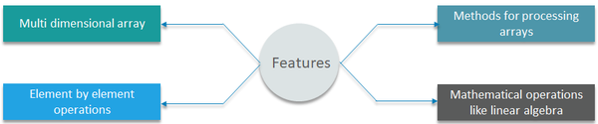
what is NumPy? How is it used?
NumPy is the most basic yet a powerful package for computing scientific, mathematical and data manipulation in Python. It helps as to do the mathematical and scientific operation and used extensively in data science. It allows us to work with multi-dimensional arrays and matrices.
Other usages are in:
- Numerical Analysis - Linear algebra - Matrix computations
- random number generation
Numpy used for computing scientific/mathematical data.
Other usages are in:
- Numerical Analysis
- Linear algebra
- Matrix computations
NumPy is a package in Python used for Scientific Computing
https://www.quora.com/In-Python-what-is-NumPy-How-is-it-used

Slide 3
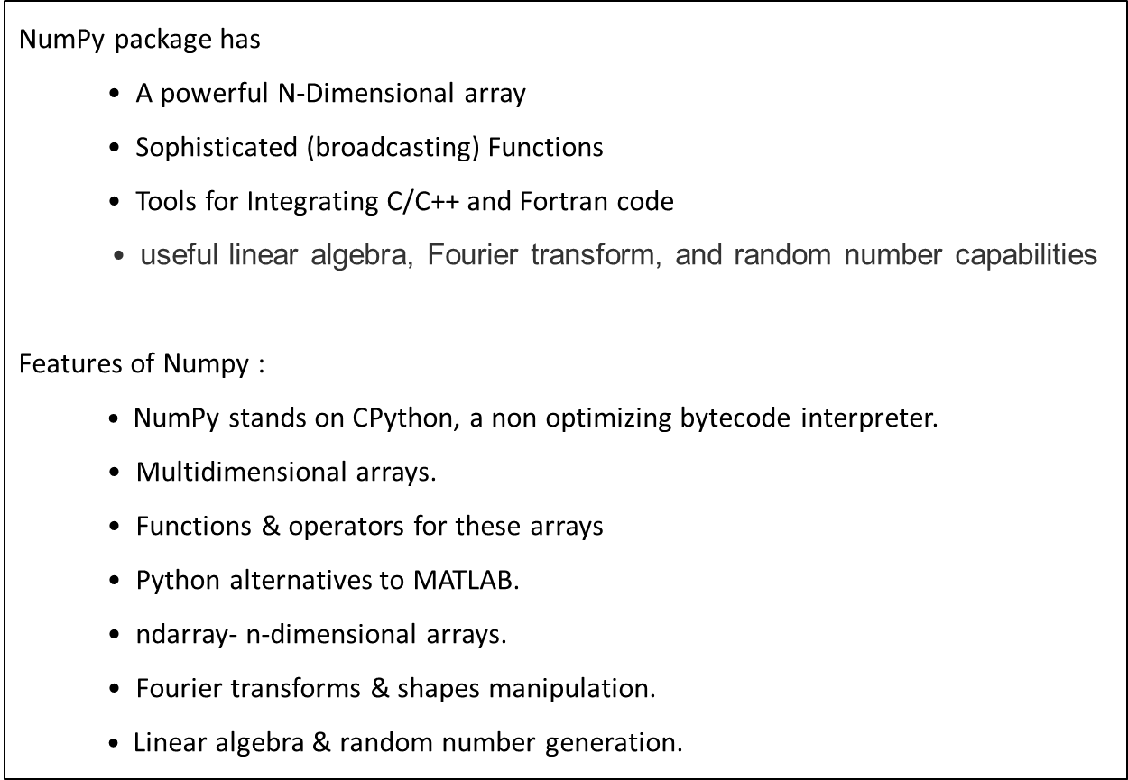
NumPy package has
• A powerful N-Dimensional array
• Sophisticated (broadcasting) Functions
• Tools for Integrating C/C++ and Fortran code
• useful linear algebra, Fourier transform, and random number capabilities
Features of Numpy :
$•$NumPy stands on CPython, a non optimizing bytecode interpreter.
• Multidimensional arrays.
• Functions & operators for these arrays
• Python alternatives to MATLAB.
• ndarray- n-dimensional arrays.
• Fourier transforms & shapes manipulation.
$•$Linear algebra & random number generation.
Mathematical Operations :
a. max
b. min
c. median
d. sum
e. Addition
f. subtraction
g. multiplication
h. division
i. square root
j. standard deviation
You can use numpy for:
1. Financial functions
2. Linear Algebra
3. Statistics
4. Polynomials
5. Sorting, searching etc.
Numerical operations like calculating mean, median, standard deviation, determinant of matrix, transpose of matrix.

Slide 4
1. NumPy is often used along with packages like SciPy (Scientific Python) and Mat−plotlib (plotting library).
2. This combination is widely used as a replacement for MatLab, a popular platform for technical computing.
3. Python alternative to MatLab is now seen as a more modern and complete programming language.
4. Standard Python distribution doesn't come bundled with NumPy module. Install NumPy using popular Python package installer, pip.
pip install numpy
5. Numpy is powerful library for matrices computation.

Slide 5
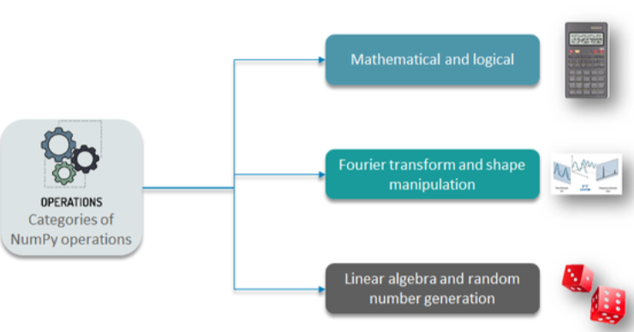
NumPy package is used to perform different operations.

Slide 6
It gives an ability to create multidimensional array objects and perform faster mathematical operations.
The library contains a long list of useful mathematical functions, including some functions for linear algebra and complex mathematical operations such as Fourier Transform (FT) and random number generator (RNG).
Most of the other libraries that we use in data analytics with Python, such as scikit-learn, SciPy and Pandas use some of NumPy's features.
Operations on NumPy Arrays
Indexing
Slicing
Algebra with Arrays
Arithmetic Operations
Mathematical Operations
Aggregate and Statistical Functions

